Slide 1


Course Registration System
Notes:
Hi Everyone,
Good Morning
Before we start with the presentation today, I would like to share a small recital.
We have been a part of Publicis Sapient for almost 3months now, and there is this fact that everyone of us would agree upon.
We all started as fresh graduates, underwent 5weeks or so of rigorous training followed by what…5 weeks now of a Hands On project, and what has transpired in these days is a fact that we all are really proud of. A transformation from someone who could code, to someone who can not only code, but add value to everything he does.
So have we succeeded at becoming a Product engineer?
Hi, I am Rajat, a small part of our big team here.
I am here with my colleagues Aman and Chinmay and we are here to give you a walkthrough of our Transformation, our Journey and the project we have been working for sometime now.

Slide 2
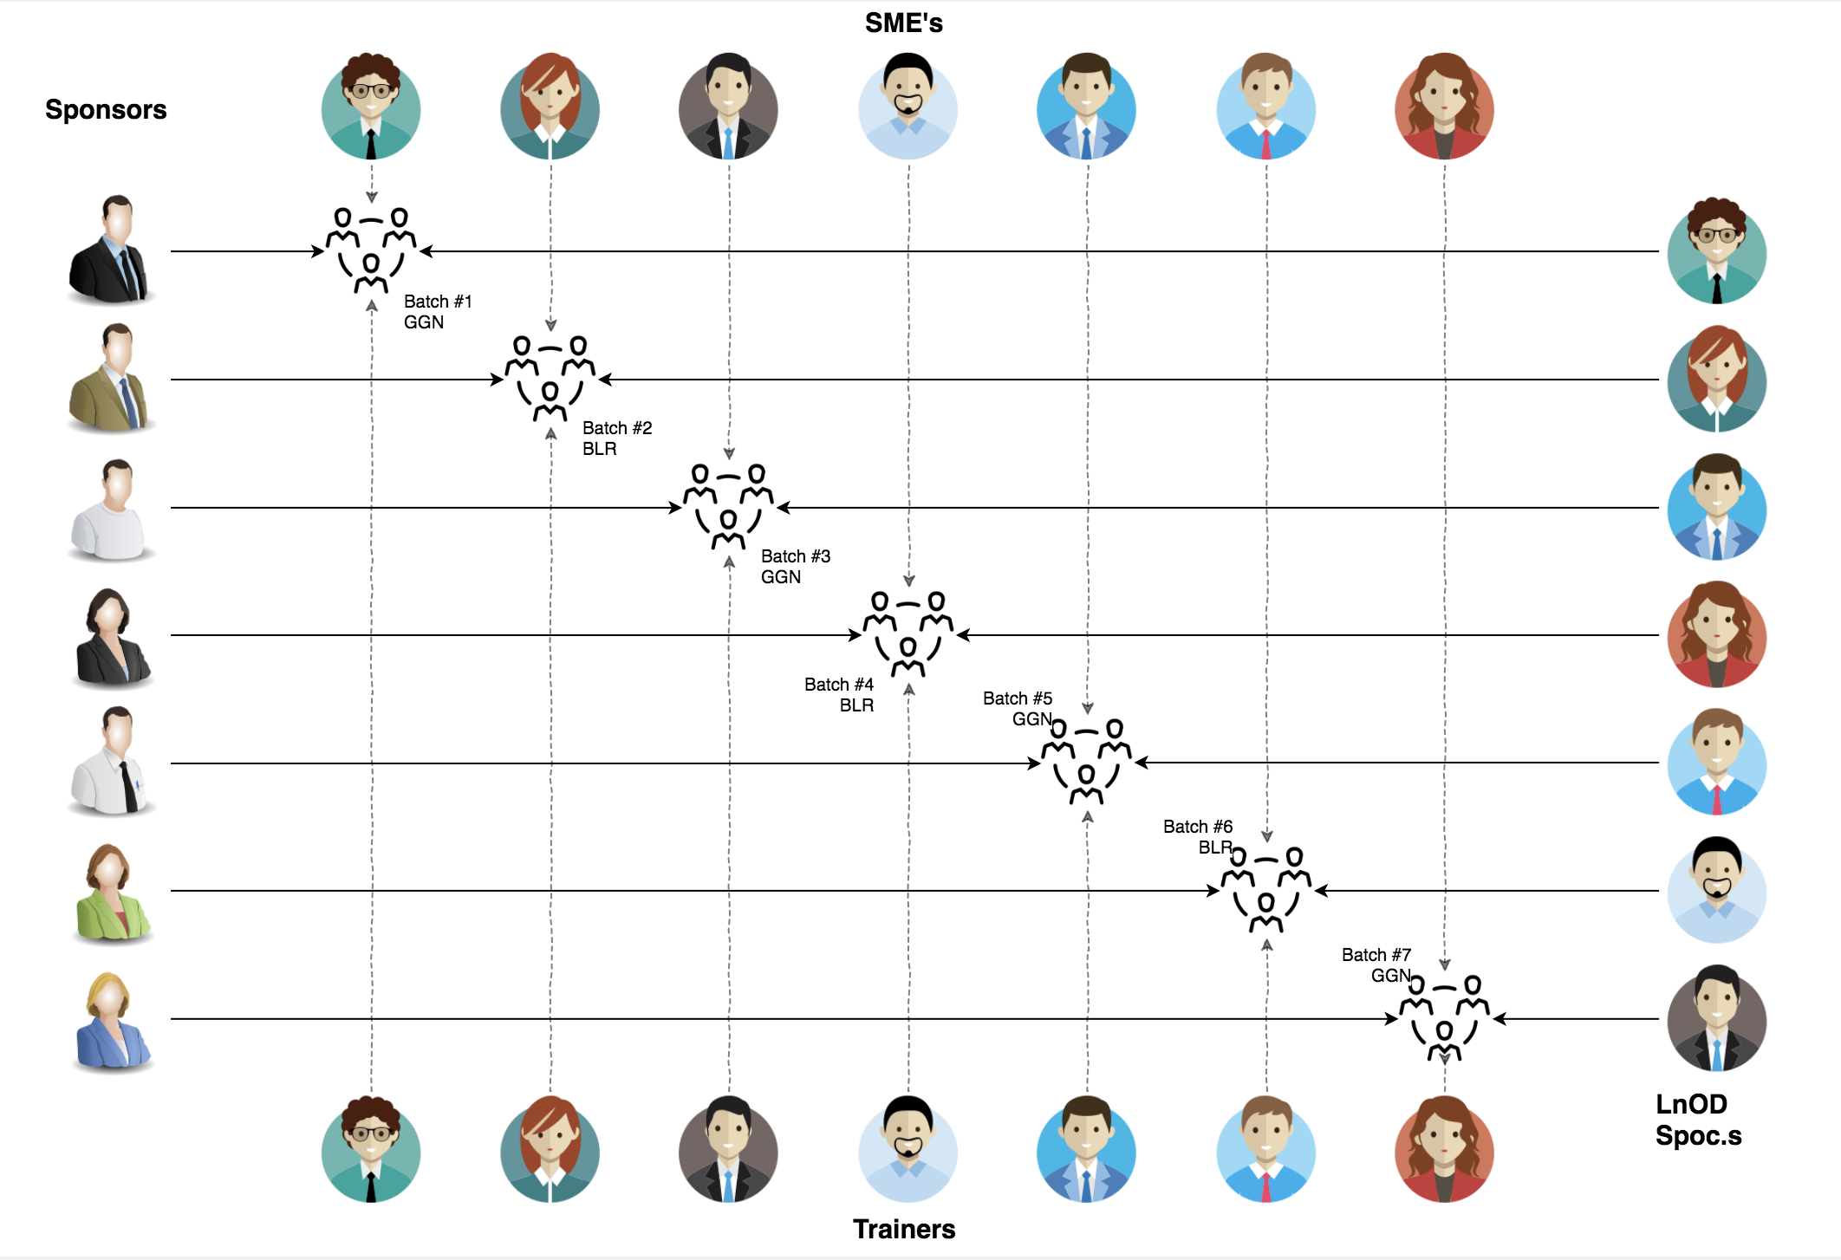
Stakeholders
Sponsors
Flipkart
SME
Amit Balyan
3. HR’s and Coordinates
Heena Bansal
Sharath Ramesha(L&D Team,Flipkart)

Slide 3

Agenda
01
Our Journey
02
Our Team
03
Team Structure
04
Problem Statement
05
Engineering Practices
06
Tech Stack
07
Development
08
Challenges & Learnings
09
Demo
10
Questions
Notes:
Time – 1 min

Slide 4
Our Journey
Notes:
Time - 2 mins

Slide 5




Understanding Project goals and learning basics like Git & Linux
Step 1
Step 2
Deciding the technologies: JAVA/REST
Step 3
Design Thinking
And UML modelling
Step 4
Learning technologies and implementation
Step 5
Project Demonstration

Slide 6
ACTION PLAN
 | Modules | Description
Week 1 | UNIX GIT UML Diagrams | Understanding Unix and Git commands Requirement understanding and diagram design
Week 2 | Java 8 Exception Handling SQL | Developing a POS Application using Java and MySQL. Understanding Java 8 features and collections
Week 3 | Jersey and DropWizard | REST API Development using Jersey and DropWizard framework

Slide 7
Our next starts
NOW
Notes:
Time – 1 min
Swati

Slide 8
Our Team
Notes:
Time – 2 mins

Slide 9
Name | Responsibility
Aarthi Sree Mundla | Use case diagram, Student DA0,AdminRest controller
Aayush Singh Naruka | Activity diagram,Admin dao operation
Chirag Agrawal | StudentRestAPI Controller, Payment DAO
Harman Marshal Singh | UserRest Controller, PaymentRest Controller
Priyanshu Mangal | Admin service operation Use case Diagram:admin
S Ruthvik Reddy | Sequence Diagram, Payment pos
Somil Singla | Class diagram, AdminRest controller
Notes:
Name alongwith responsibilities

Slide 10

Project Goals
Notes:
Time – 3 mins

Slide 11




Problem Statement
To develop a POS application and REST API for Course Registration System using JAVA where the student can register, add/drop course, professors can view courses, enrolled students while admin can manage users, add/drop courses to catalog
1
2
Quality
Security
3
4
Interactivity
Speed
Notes:
User satisfaction and brand value
Problem Statement

Slide 12

Engineering Practices
Notes:
Time – 5 mins

Slide 13
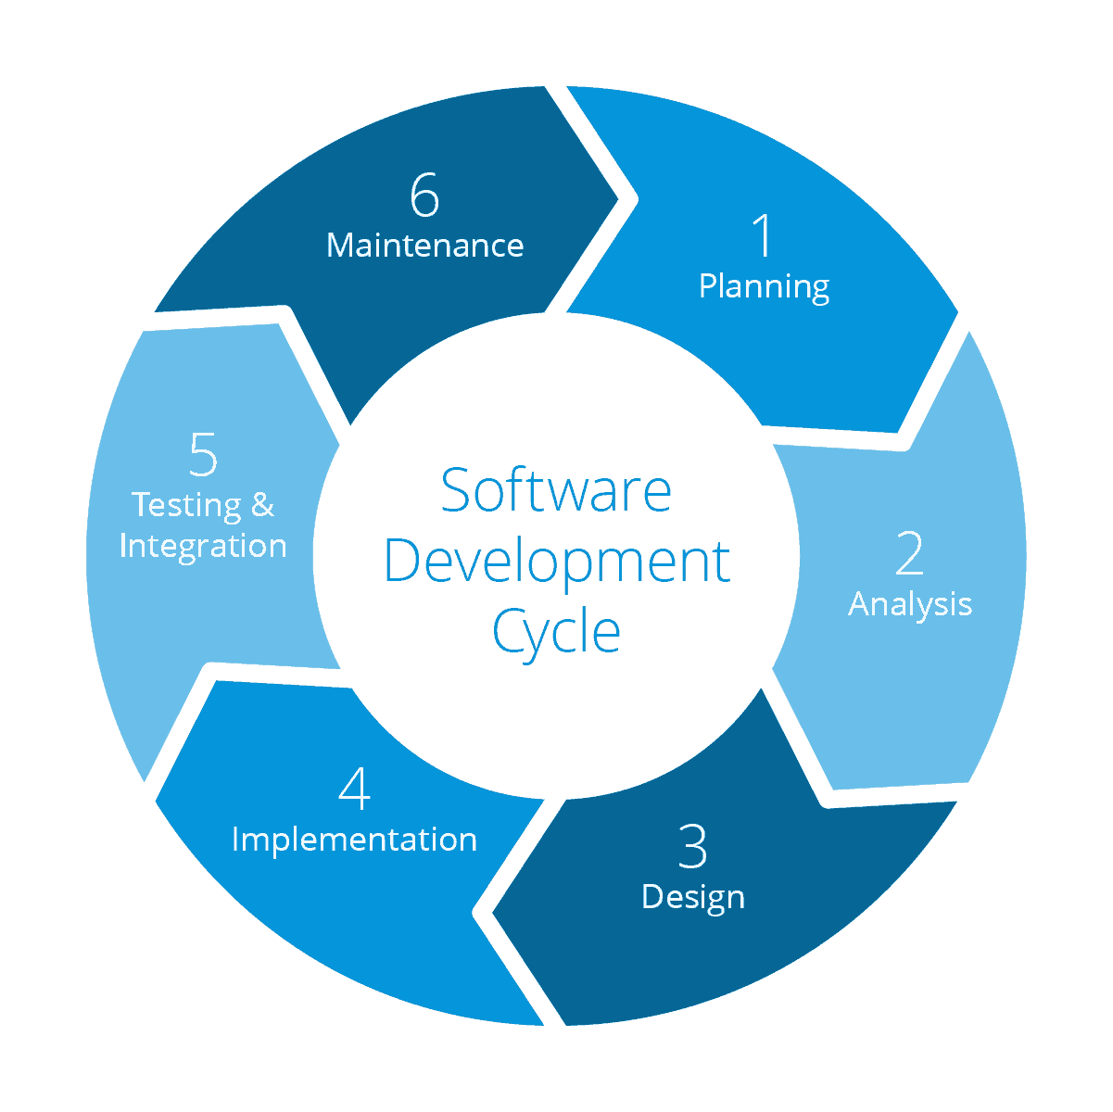
Requirement Gathering
Tech Stack Selection
UML Artifacts, Architecture Design
Code development
Notes:
Implementation ->

Slide 14
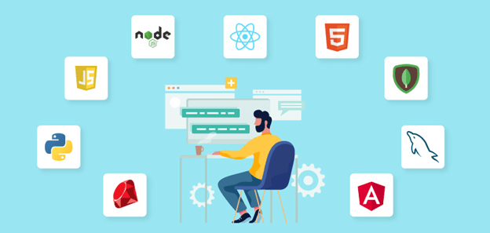
Tech Stack
Notes:
Time – 2 mins

Slide 15










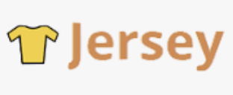

Designing
Backend
Testing
Data
SCM
UML
Core Language
Tools
SQL Database
Code Collaboration
Framework
Notes:
Time – 1 min
Java
Maven
DropWizard
MySQL
Jersey
GitHub
Postman / ARC (Check it)
StarUML / Dia / Lucid Charts
List
Design
Backend
Testing
Tools

Slide 16
UML MODELLING
As a part of software designing phase, we used UML modelling language for representing problem into graphical form as per best engineering practices.

Slide 17
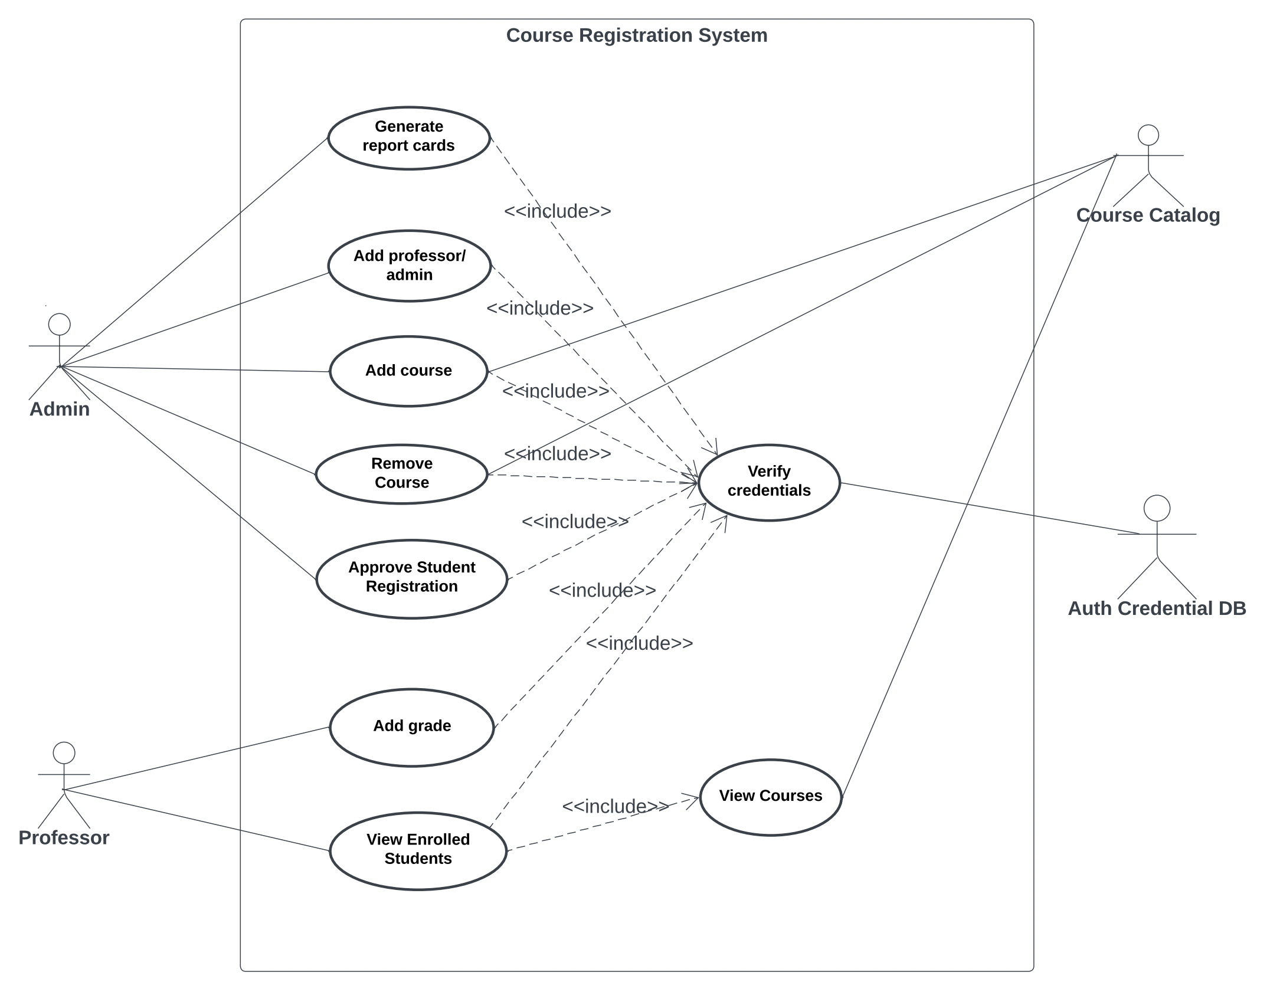
1. Use Case
Diagrams

Slide 18
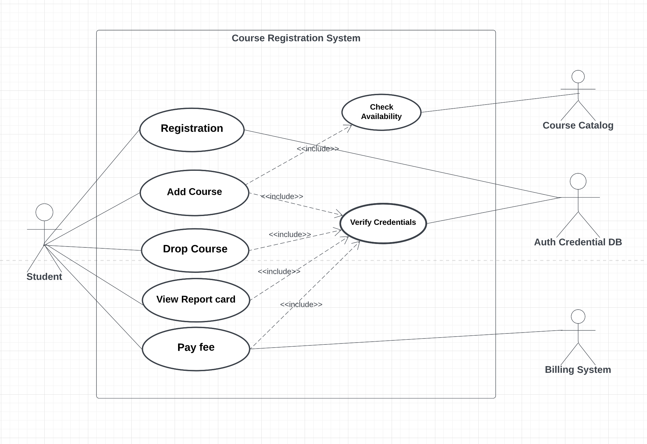

Slide 19
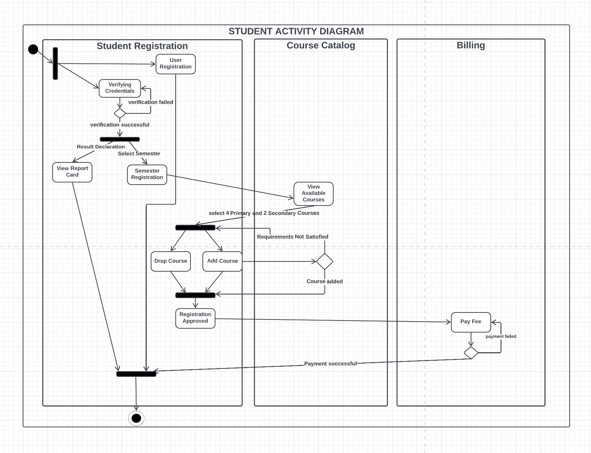
2. Activity
Diagrams

Slide 20
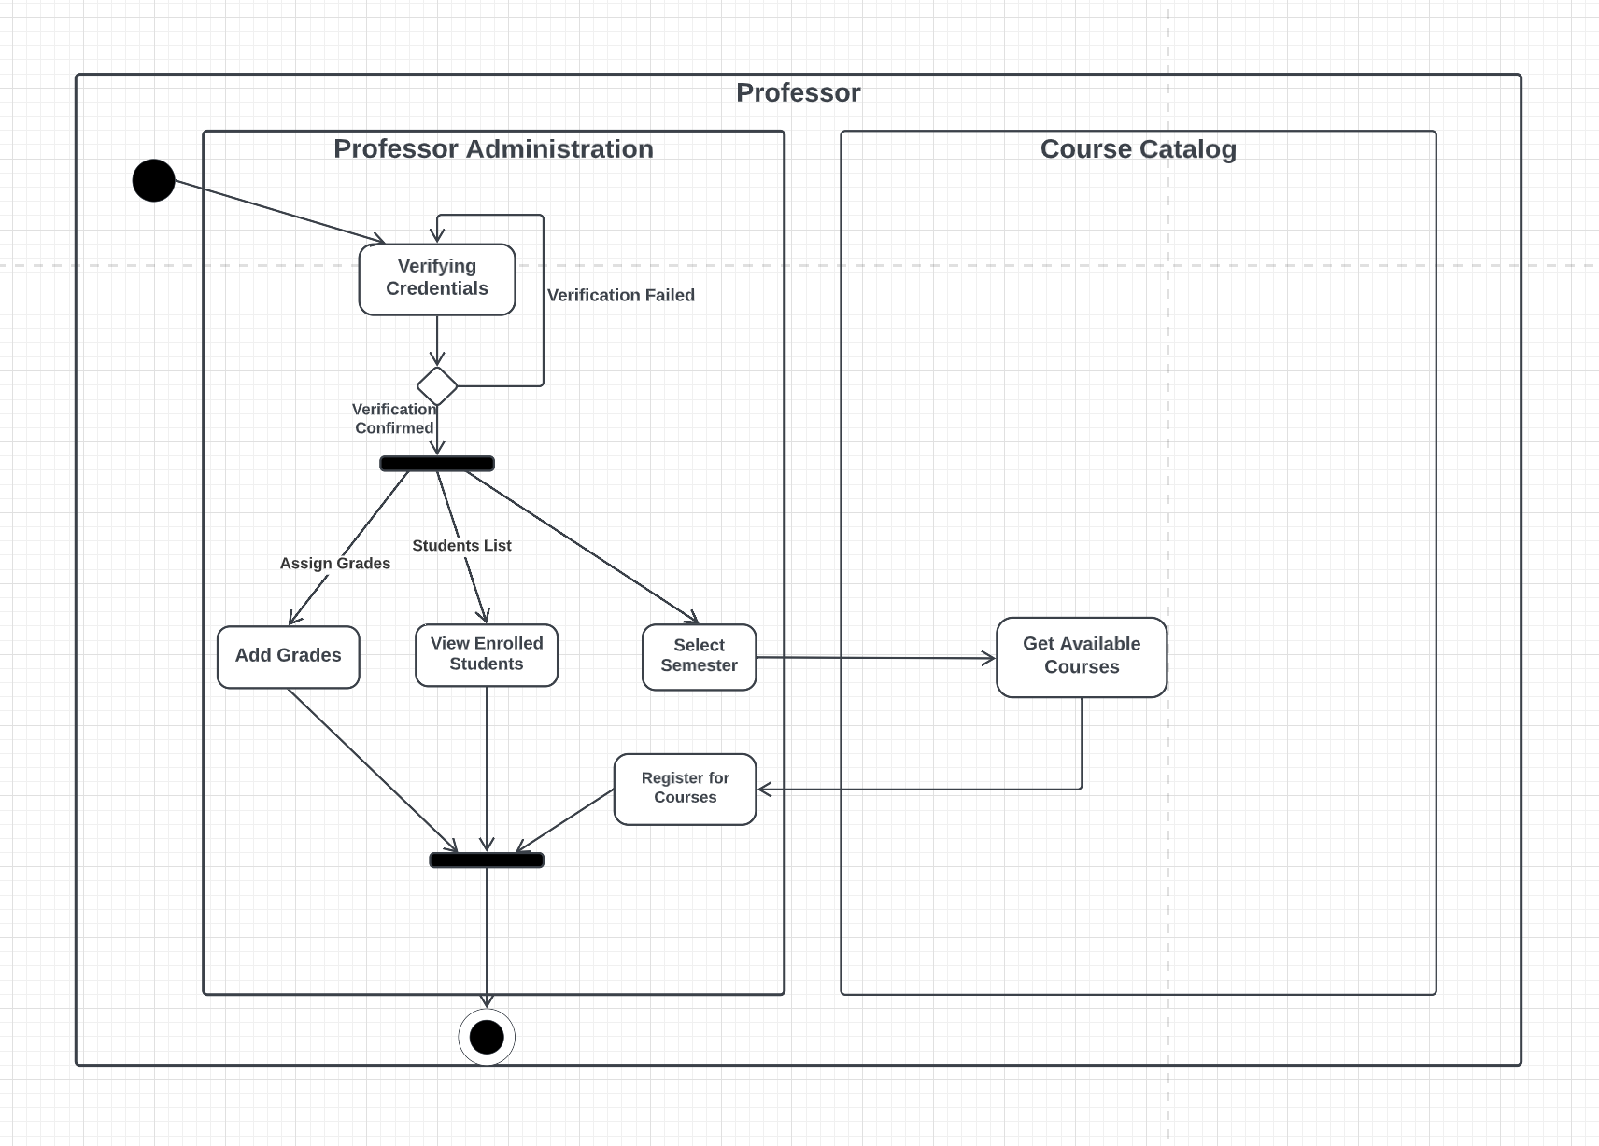

Slide 21
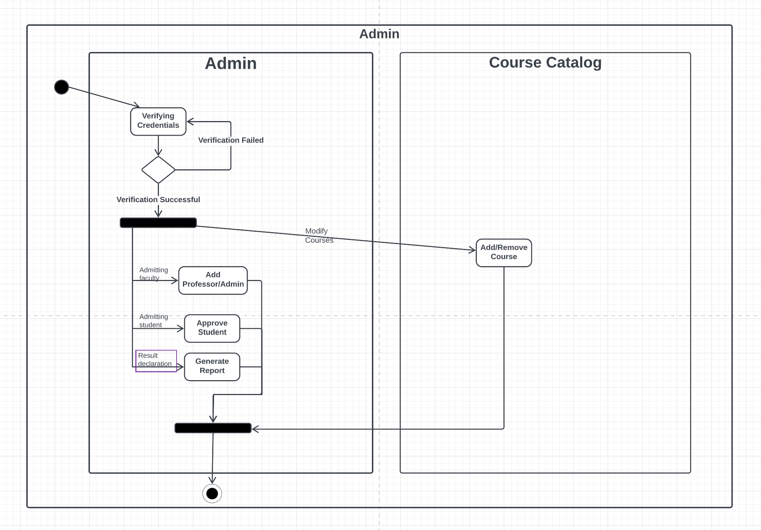

Slide 22
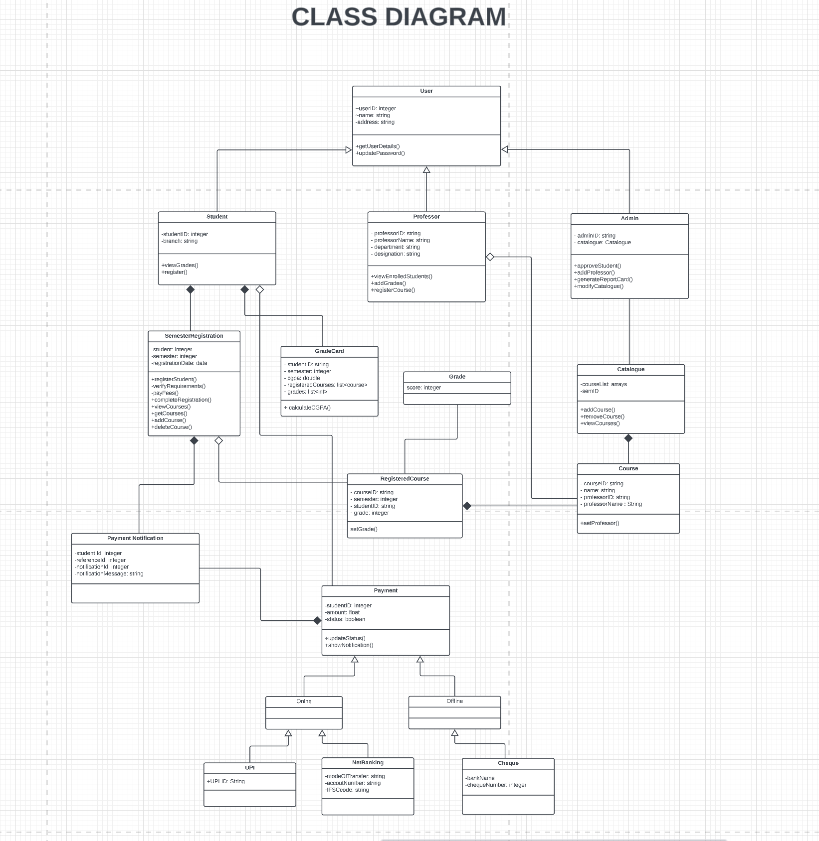
3. Class Diagram

Slide 23
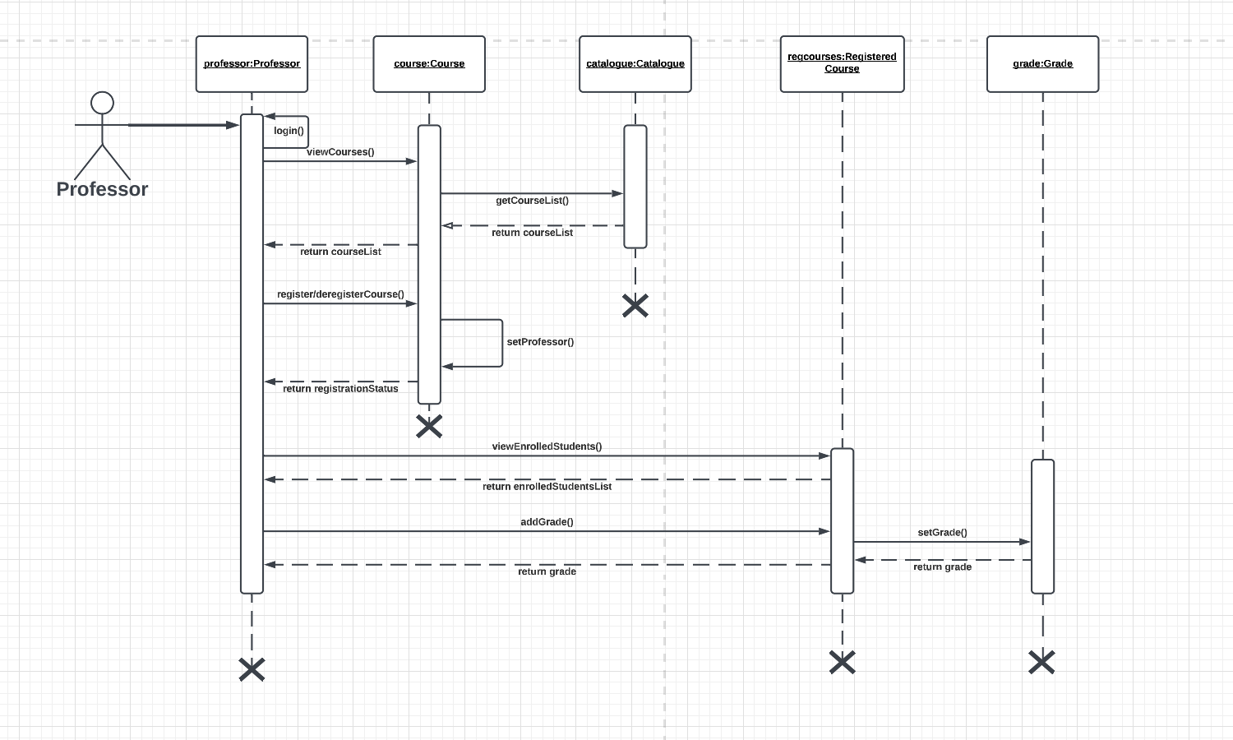
4. Sequence
Diagrams

Slide 24
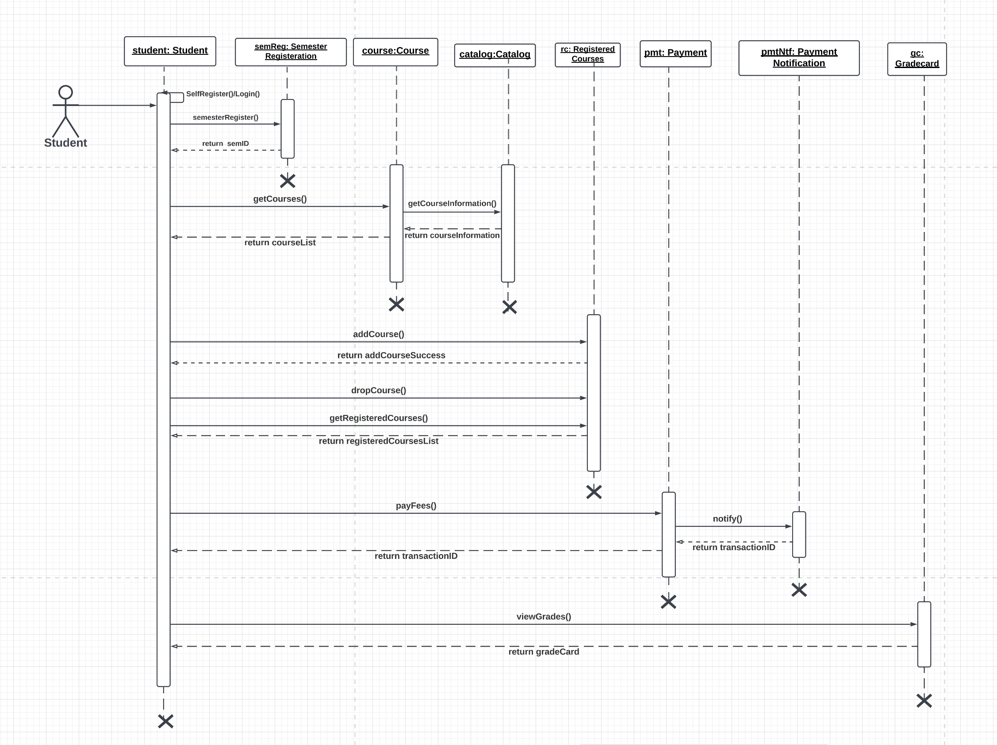

Slide 25
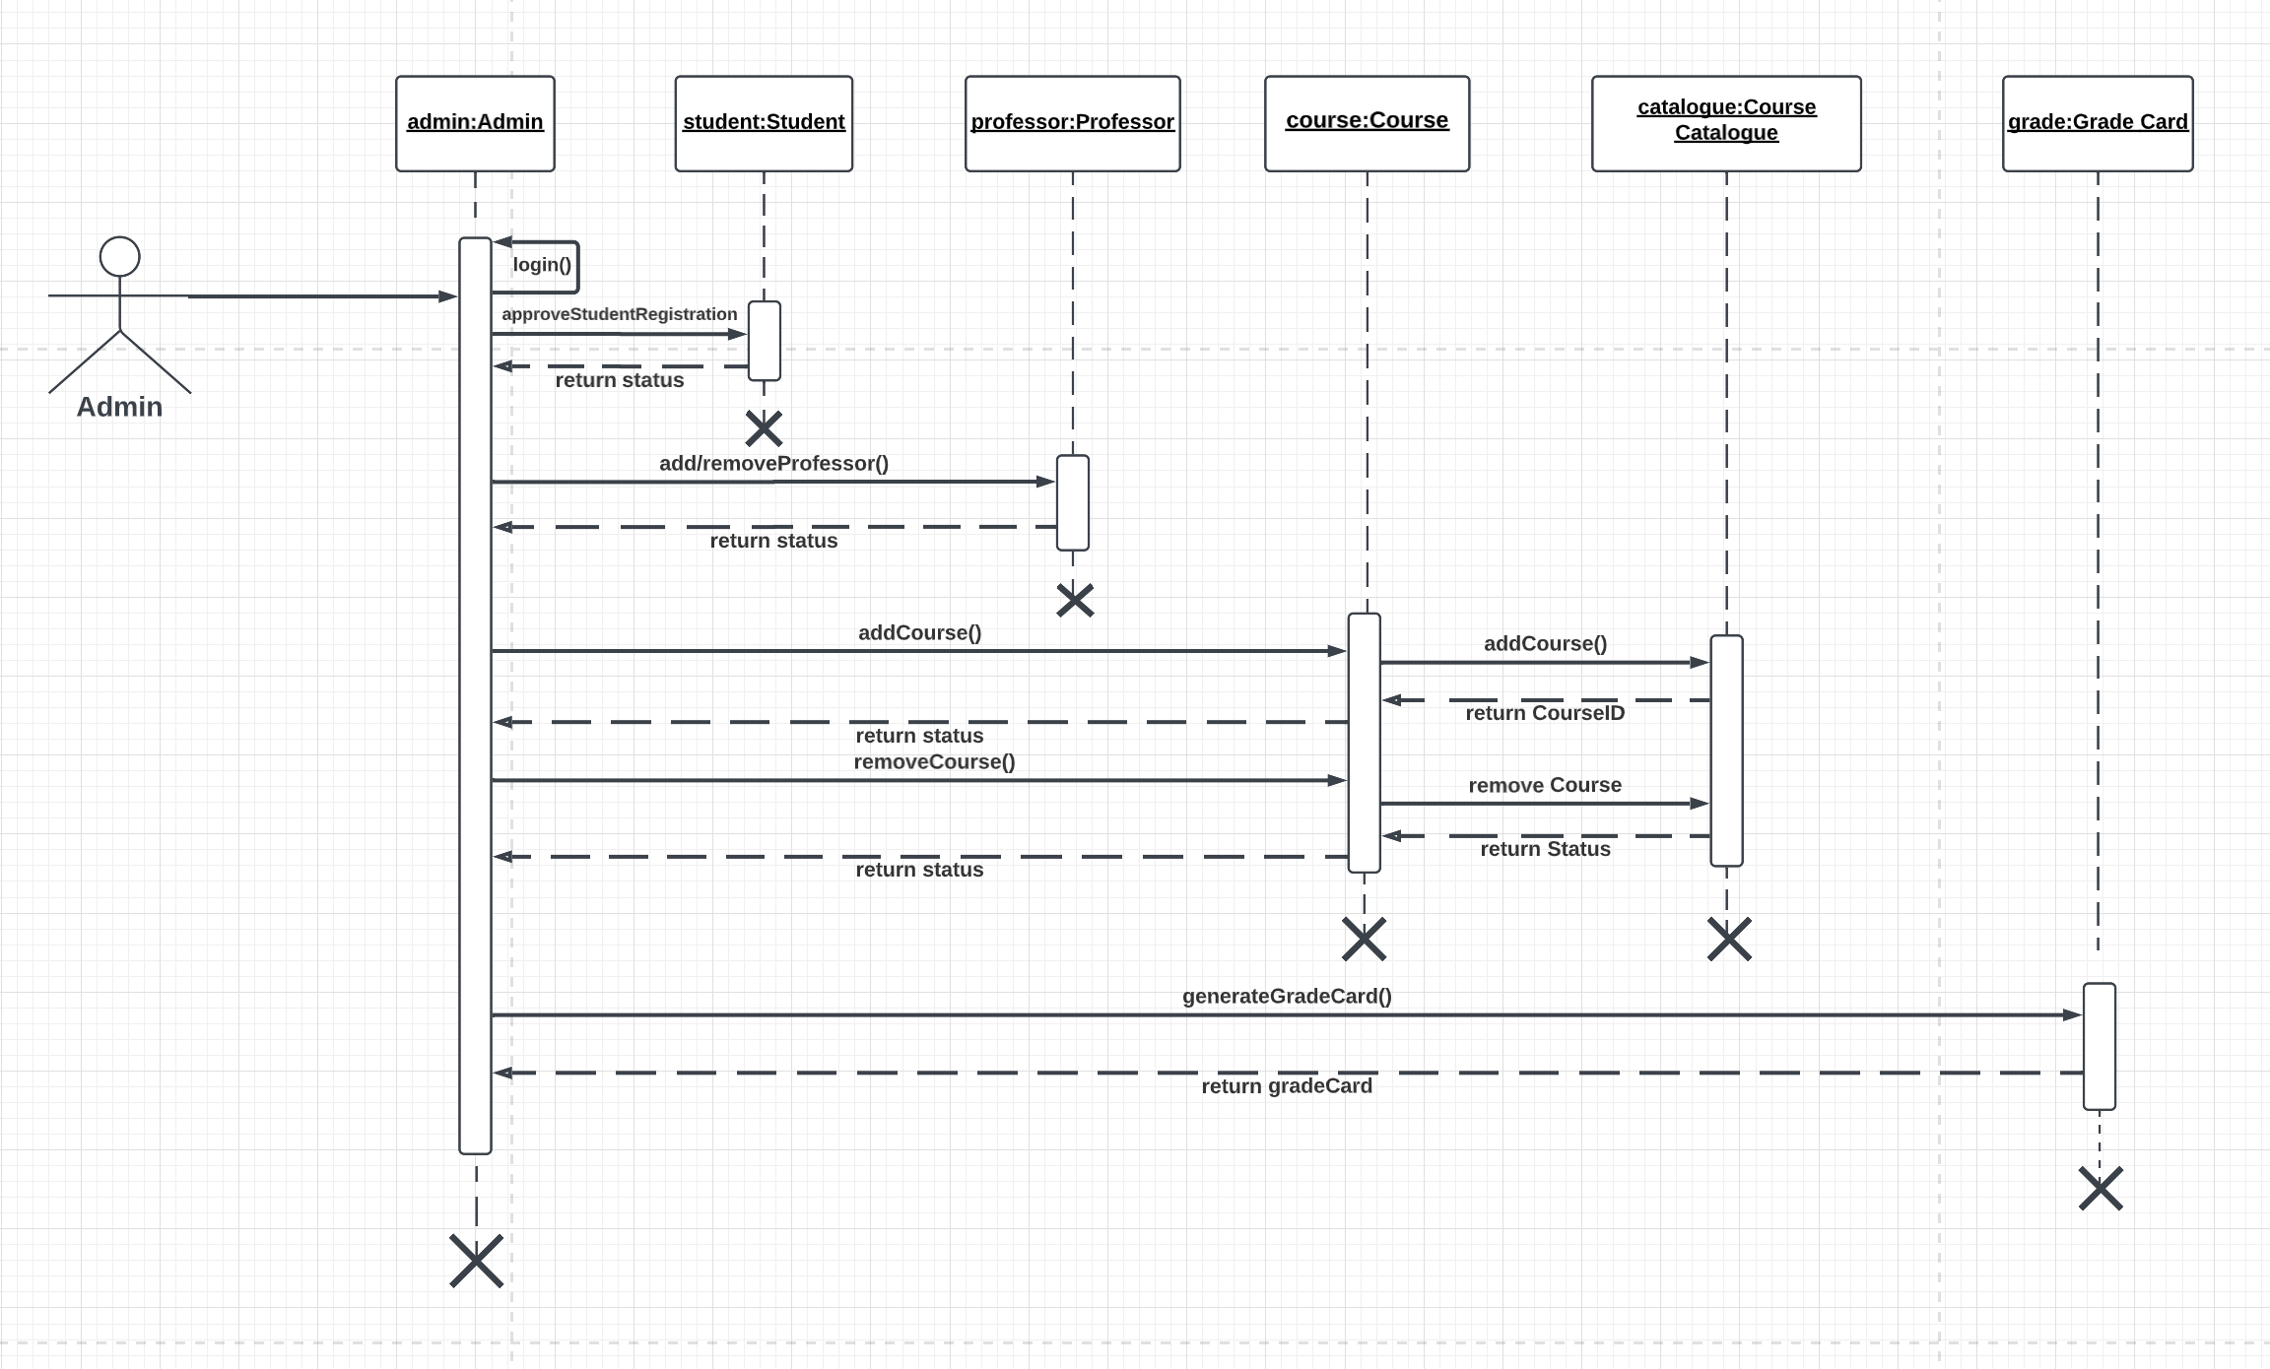

Slide 26
DATABASE SCHEMA DESIGNING

Slide 27
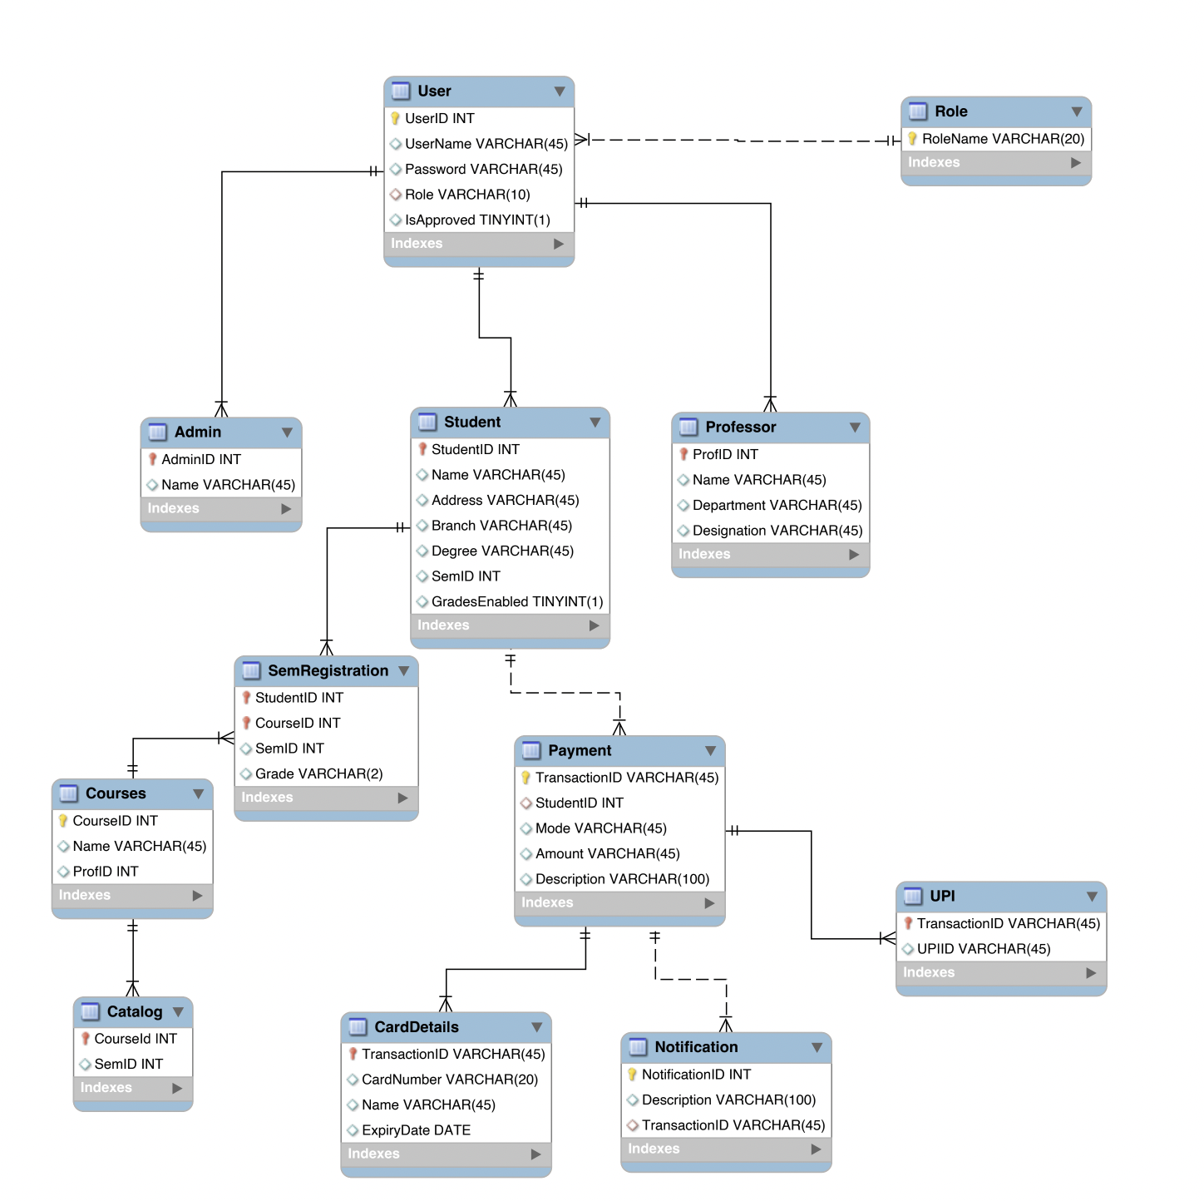

Slide 28

Challenges & Learnings
Notes:
Time – 2 mins

Slide 29
 | Challenges | Learning
Week 1 | Understanding the problem statement Collaboration issues such as merge conflicts in Git UML diagram conventions | UNIX Git commands UML Diagrams
Week 2 | Installation softwares on multiple environments POS application development using layered architecture | Java 8 Exception Handling SQL
Week 3 | Resolving jar and version dependencies Passing Query params(data) to test in Postman | REST API development using Jersey and DropWizard Maven DropWizard

Slide 30

Architecture Design
Notes:
Time – 1 min

Slide 31

POS Application
Java Main Client
Business Code
Database Code
HTTP Request
HTTP Response
Notes:
n-tier

Slide 32

Demo
Notes:
Time –
Architecture – 5 mins
NFR Dashboard – 3 mins
Demo – 10 mins
1. Show the Responsiveness and Wave tool first

Slide 33

Questions
Notes:
Time - ?

Slide 34
Thank you
Notes:
Time – After this show the testimonial video. 1 min

